Slide 1
Observer Pattern Group 7
Hồ Sỹ Nguyên
Lâm Lê Thanh Thế
Trần Trí Thiện
Nguyễn Trần Phước Thịnh

Slide 2
PROBLEM
A
B
?

Slide 3
PROBLEM
class A
{
public:
…
void getter();
private: };
class B
{
public:
…
private: };

Slide 4
DRAWBACK
Expose the data: Every other function can use the getters to retrieve private values.
Hard to keep track of data changes: After getting, outside functions will not know if data are modified or not, unless they store previous data to compare.

Slide 5
Class Diagram
for
Observer Design Pattern

Slide 6
Class Diagram for Observer Design Pattern
observing
A
B
getter()
update()

Slide 7
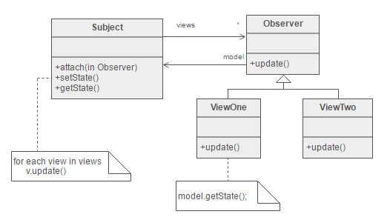
Subject has the “HAS-A” relationship with the observer
ViewOne and ViewTwo are concrete classes of the abstract class Observer.
The Subject can tell the Observers to do their things.
The Observers can call back to the Subject if needed.

Slide 8
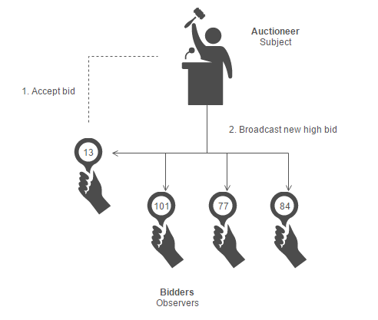
In real life, an auction is similar to this design pattern.
The auctioneer tells the bidders to start bidding (notify)
The bidders will the call back to the auctioneer when they accept a certain bid.
This auctioneer will then update the bids to all the bidders.

Slide 9
Similar Problem
A: Do you want to buy a Ti vi?
B: Do you want to buy a Tủ lạnh?
Customer
C: Do you want to buy a Máy lạnh?
D: Do you want to buy a Máy giặt?

Slide 10
Similar Problem
A: Do you want to buy a Ti vi?
B: Do you want to buy a Tủ lạnh?
Customer
C: Do you want to buy a Máy lạnh?
D: Do you want to buy a Máy giặt?
=> Mediator Pattern

Slide 11
Pros and Cons
+ Pros:
- Allows you to send data to many other objects in a very efficient manner.
- Easy to subscribe and remove observers.
+ Cons:
- Can cause memory leaking.
- Can cause performance degradation.
- The order of the notification is dependable.

